Slide 1
Machine Learning and Deep Learning
Dr.K DeviPriya
Professor
Computer Science and engineering
Lakireddy Bali Reddy College of Engineering
Mylavaram

Slide 2
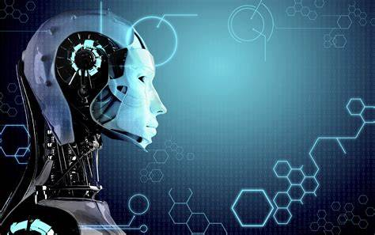
MACHINE LEARNING
MACHINE LEARNING
S

Slide 3
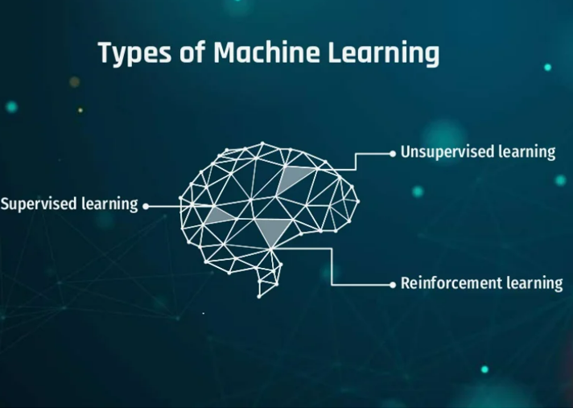

Slide 4
Machine Learning Basics
Machine learning is a field of computer science that gives computers the ability to learn without being explicitly programmed
Labeled Data
Machine Learning algorithm
Training
Prediction
Labeled Data
Learned model
Prediction
Methods that can learn from and make predictions on data

Slide 5
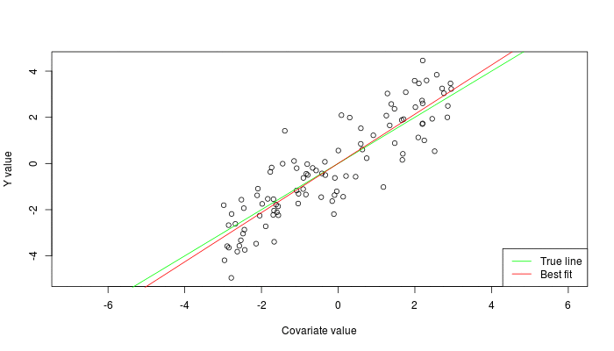

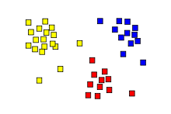
Types of Learning
Supervised: Learning with a labeled training set
Example: email classification with already labeled emails
Unsupervised: Discover patterns in unlabeled data
Example: cluster similar documents based on text
Reinforcement learning: learn to act based on feedback/reward
Example: learn to play Go, reward: win or lose
class A
class A
Classification
Regression
Clustering
Anomaly Detection
Sequence labeling
…
http://mbjoseph.github.io/2013/11/27/measure.html

Slide 6
Neural Network
Neural networks are machine learning models that mimic the complex functions of the human brain. These models consist of interconnected nodes or neurons that process data, learn patterns and enable tasks such as pattern recognition and decision-making.

Slide 7
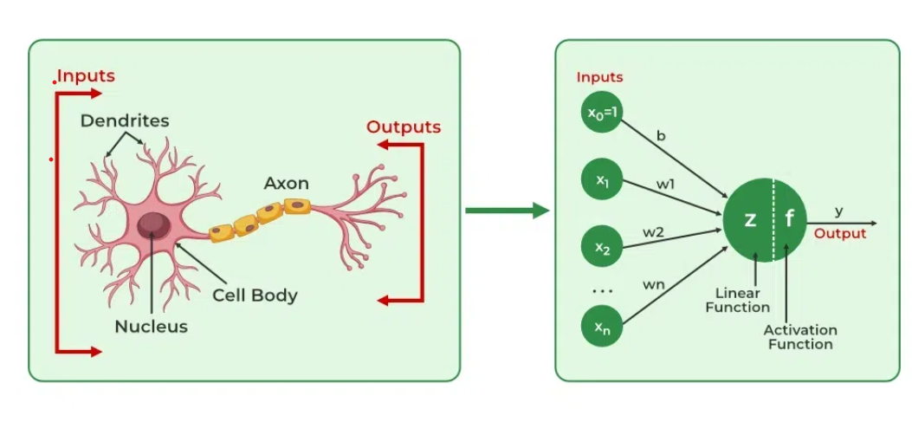

Slide 8
Importance
Identify Complex Patterns: Recognize intricate structures and relationships in data; adapt to dynamic and changing environments.
Learn from Data: Handle vast datasets efficiently; improve performance with experience and retraining.
Drive Key Technologies: Power natural language processing (NLP); enable self-driving vehicles; support automated decision-making systems.
Boost Efficiency: Streamline workflows and processes; enhance productivity across industries.
Backbone of AI: Serve as the core driver of artificial intelligence progress; continue shaping the future of technology and innovation.

Slide 9
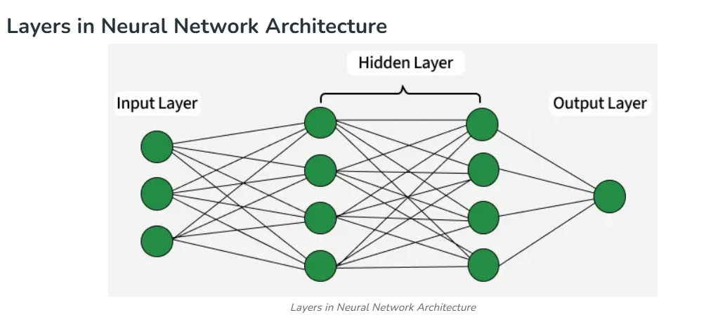
Layers

Slide 10
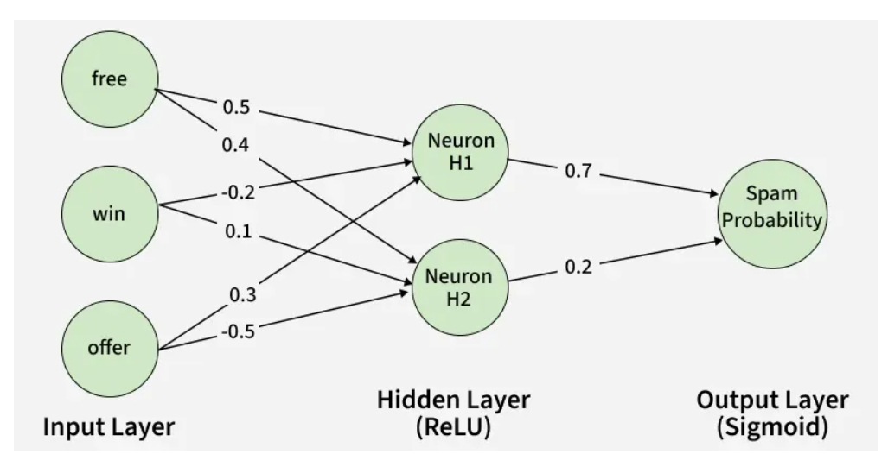
Spam Mail classification with Input Vector- [1,0,1]-Weights:
Neuron H1: [0.5,−0.2,0.3]
Neuron H2: [0.4,0.1,−0.5]

Slide 11
Input Vector: [1,0,1]
Weighted Sum Calculation
For H1: (1×0.5)+(0×−0.2)+(1×0.3)=0.5+0+0.3=0.8
For H2: (1×0.4)+(0×0.1)+(1×−0.5)=0.4+0−0.5=−0.1
Activation Function
Here we will use ReLu activation function:
H1 Output: ReLU(0.8)= 0.8
H2 Output: ReLu(-0.1) = 0
3. Output Layer: The activated values from the hidden neurons are sent to the output neuron where they are again processed using a weighted sum and an activation function.

Slide 12
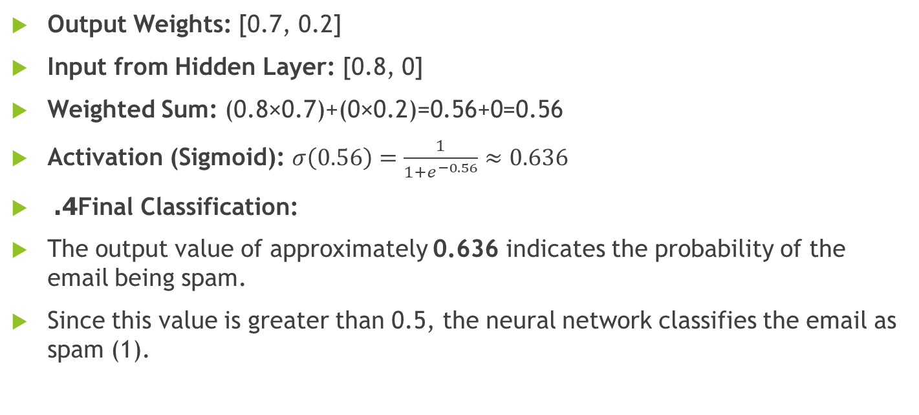
Output Weights: [0.7, 0.2]
Input from Hidden Layer: [0.8, 0]
Weighted Sum: (0.8×0.7)+(0×0.2)=0.56+0=0.56
Activation (Sigmoid): $σ\left(0.56\right)=\frac{1}{1+e^{−0.56}}≈0.636$
4. Final Classification:
The output value of approximately 0.636 indicates the probability of the email being spam.
Since this value is greater than 0.5, the neural network classifies the email as spam (1).

Slide 13
Types of Neural Networks
There are seven types of neural networks that can be used.
Feedforward Networks: It is a simple artificial neural network architecture in which data moves from input to output in a single direction.
Singlelayer Perceptron: It has one layer and it applies weights, sums inputs and uses activation to produce output.
Multilayer Perceptron (MLP): It is a type of feedforward neural network with three or more layers, including an input layer, one or more hidden layers and an output layer. It uses nonlinear activation functions.
Convolutional Neural Network (CNN): It is designed for image processing. It uses convolutional layers to automatically learn features from input images, enabling effective image recognition and classification.
Recurrent Neural Network (RNN): Handles sequential data using feedback loops to retain context over time.
Long Short-Term Memory (LSTM): A type of RNN with memory cells and gates to handle long-term dependencies and avoid vanishing gradients.

Slide 14
Create and Load Data Set
attendance,marks,assignment,result
85,78,80,1
60,55,50,0
90,88,92,1
40,35,45,0
70,65,68,1
50,45,40,0
95,90,94,1
30,25,20,0

Slide 15
Import Libraries
import numpy as np
import pandas as pd
from tensorflow.keras.models import Sequential
from tensorflow.keras.layers import Dense

Slide 16
Load dataset
data = pd.read_csv("student_performance.csv")
print(data.head())

Slide 17
Step 3: Split Features & Target
X = data[['attendance', 'marks', 'assignment']]
y = data['result']

Slide 18
4.Train and Test Split
X_train, X_test, y_train, y_test = train_test_split(
X, y, test_size=0.25, random_state=42
)

Slide 19
Step 5: Feature Scaling (Important for NN)
scaler = StandardScaler()
X_train = scaler.fit_transform(X_train)
X_test = scaler.transform(X_test)

Slide 20
Step 6: Build Neural Network (ANN)
model = Sequential([
Dense(8, activation='relu', input_shape=(3,)),
Dense(4, activation='relu'),
Dense(1, activation='sigmoid')
])

Slide 21
Network Structure
Input Layer (3 features)
↓
Hidden Layer (8 neurons)
↓
Hidden Layer (4 neurons)
↓
Output Layer (1 neuron)

Slide 22
Step 7: Compile Model
model.compile(
optimizer='adam',
loss='binary_crossentropy',
metrics=['accuracy']
)

Slide 23
Step 8: Train Neural Network
model.fit(X_train, y_train, epochs=100, verbose=1)

Slide 24
Step 9: Evaluate Model
loss, accuracy = model.evaluate(X_test, y_test)
print("Accuracy:", accuracy)

Slide 25
Step 10: Predict New Student
new_student = scaler.transform([[75, 70, 72]])
prediction = model.predict(new_student)
if prediction > 0.5:
print("PASS")
else:
print("FAIL")

Slide 26
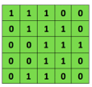
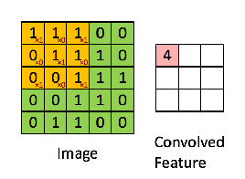

Convolutional Neural Networks (CNNs)
Compute vectors for n-grams and group them afterwards
Example: “this takes too long” compute vectors for:
This takes, takes too, too long, this takes too, takes too long, this takes too long
Convolutional
3x3 filter
Input matrix
http://deeplearning.stanford.edu/wiki/index.php/Feature_extraction_using_convolution
Notes:
http://www.asimovinstitute.org/neural-network-zoo/

Slide 27
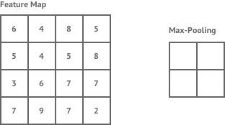
Convolutional Neural Networks (CNNs)
Main CNN idea for text:
Compute vectors for n-grams and group them afterwards
max pool
2x2 filters
and stride 2
https://shafeentejani.github.io/assets/images/pooling.gif

Slide 28
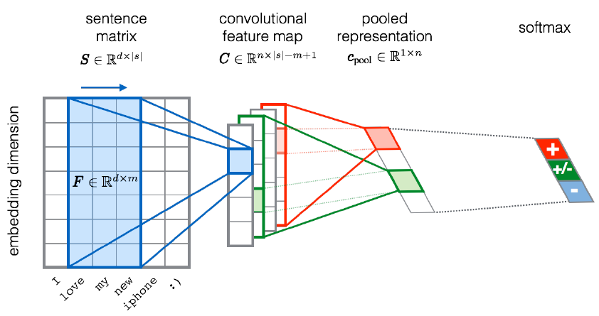
CNN for text classification
Severyn, Aliaksei, and Alessandro Moschitti. "UNITN: Training Deep Convolutional Neural Network for Twitter Sentiment Classification." SemEval@ NAACL-HLT. 2015.
Notes:
the width m of the convolution filters is set to 5
n = 300 feature maps
first layer embeds words into low-dimensional vectors.

Slide 29
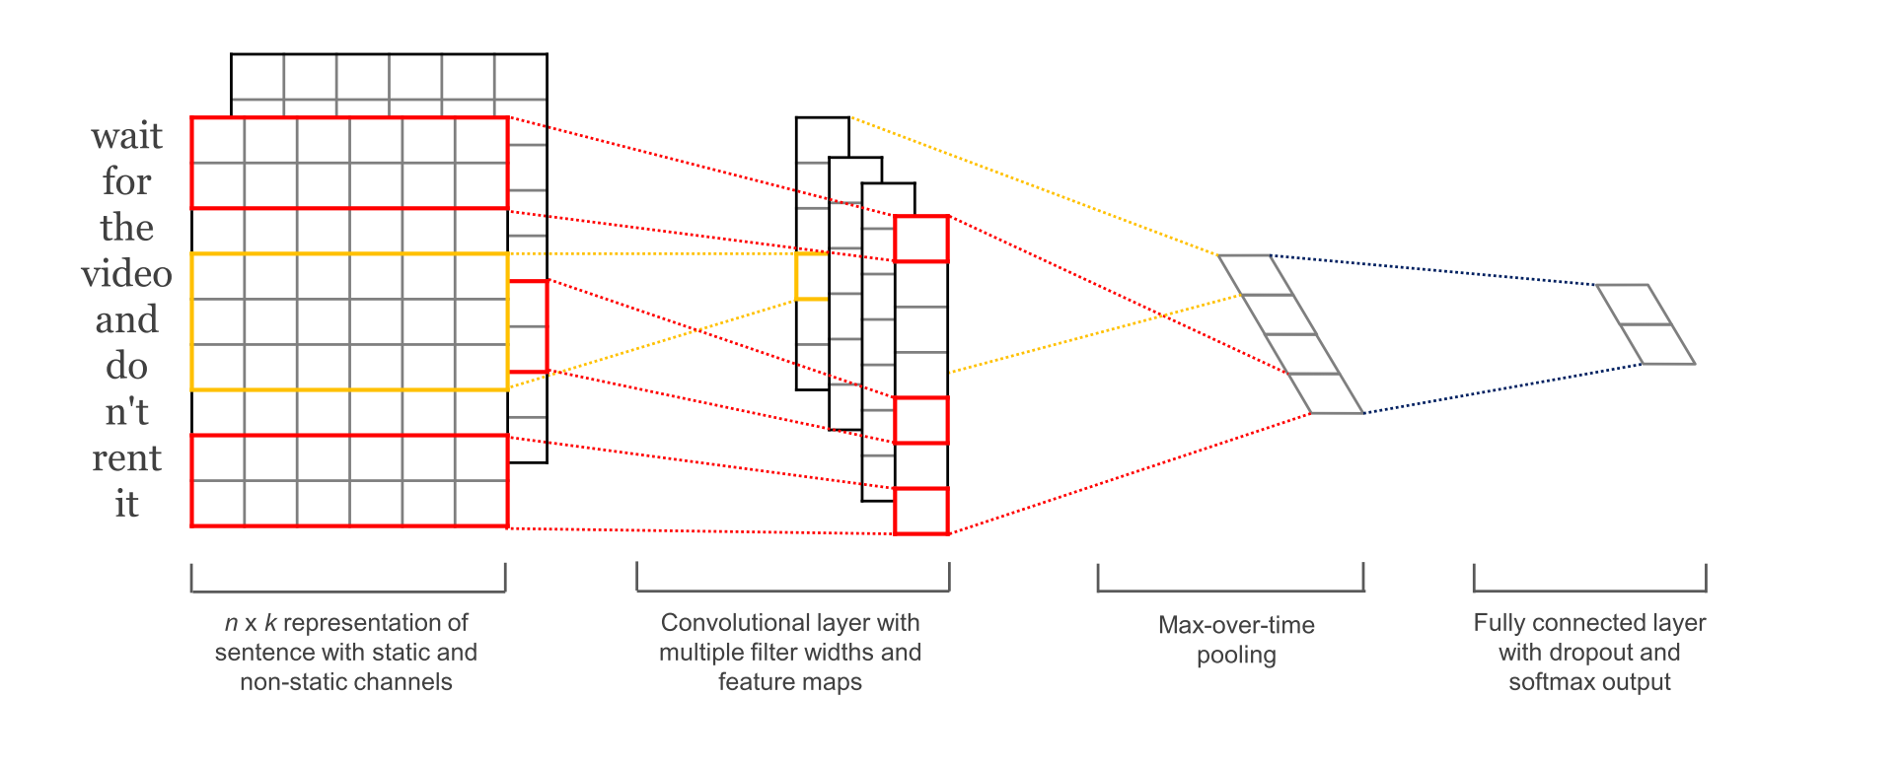
CNN with multiple filters
Kim, Y. “Convolutional Neural Networks for Sentence Classification”, EMNLP (2014)
sliding over 3, 4 or 5 words at a time

Slide 30
Deep Neural Network
Convolutional Neural Network (CNN) is a deep learning model mainly used for image data.
Unlike traditional neural networks, CNNs automatically extract features such as edges, textures, and shapes.
ANN | CNN
Needs manual feature extraction | Automatically learns features
High parameters for images | Fewer parameters
Not spatially aware | Preserves spatial structure

Slide 31
Architechture
Input Image
↓
Convolution Layer
↓
ReLU Activation
↓
Pooling Layer
↓
Flatten
↓
Fully Connected (Dense)
↓
Output (Prediction)

Slide 32
Step1 :Input Layer
TEP 1: Input Layer
Input is an image matrix
Example: 28×28×1 (MNIST grayscale image)
Height × Width × Channels

Slide 33
Convoltuion Layer
STEP 2: Convolution Layer
Uses filters (kernels) to detect features (edges, corners)
Performs dot product between filter & image patch
Feature Map = Image ⊗ Filter
Syntax:
Conv2D(filters=32, kernel_size=(3,3), strides=1, padding='same')

Slide 34
STEP 3: Activation Function (ReLU)
Introduces non-linearity
Converts negative values → 0
ReLU(x) = max(0, x)

Slide 35
STEP 4: Pooling Layer
Reduces spatial size
Keeps important features
Prevents overfitting
MaxPooling2D(pool_size=(2,2))

Slide 36
STEP 5: Flatten Layer
Converts 2D feature maps → 1D vector
Prepares data for Dense layer
Flatten()

Slide 37
STEP 6: Fully Connected (Dense Layer)
Performs classification
Learns complex combinations of features
Dense(128, activation='relu')

Slide 38
Output Layer
Problem | Neurons | Activation
Binary classification | 1 | sigmoid
Multi-class | n | softmax
Dense(10, activation='softmax')

Slide 39
COMPLETE CNN EXAMPLE (MNIST – Handwritten Digits)
Problem
Classify digits 0–9

Slide 40
Deep learning?
Deep neural networks consist of multiple layers of interconnected nodes, each building upon the previous layer to refine and optimize the prediction or categorization.

